Slide 1
Our Earth in Motion: Time, Tide and Seasons
Year 7 Science

Slide 2

Review
Draw a picture that explains time zones. | Draw a picture that explains why it is night in America when it is day in Australia.
Draw a picture that explains why it is hot in summer. | Draw a picture that explains why days are shorter in winter (especially the further you go from the equator)

Slide 3
Learning Intentions
Predictable phenomena on Earth, including seasons and eclipses, are caused by the relative positions of the Sun, Earth and the Moon.

Slide 4
Success criteria
Explain what causes tides
Describe spring tides and neap tides.
Investigate tide charts.

Slide 5
Time Tide and Seasons

Slide 6
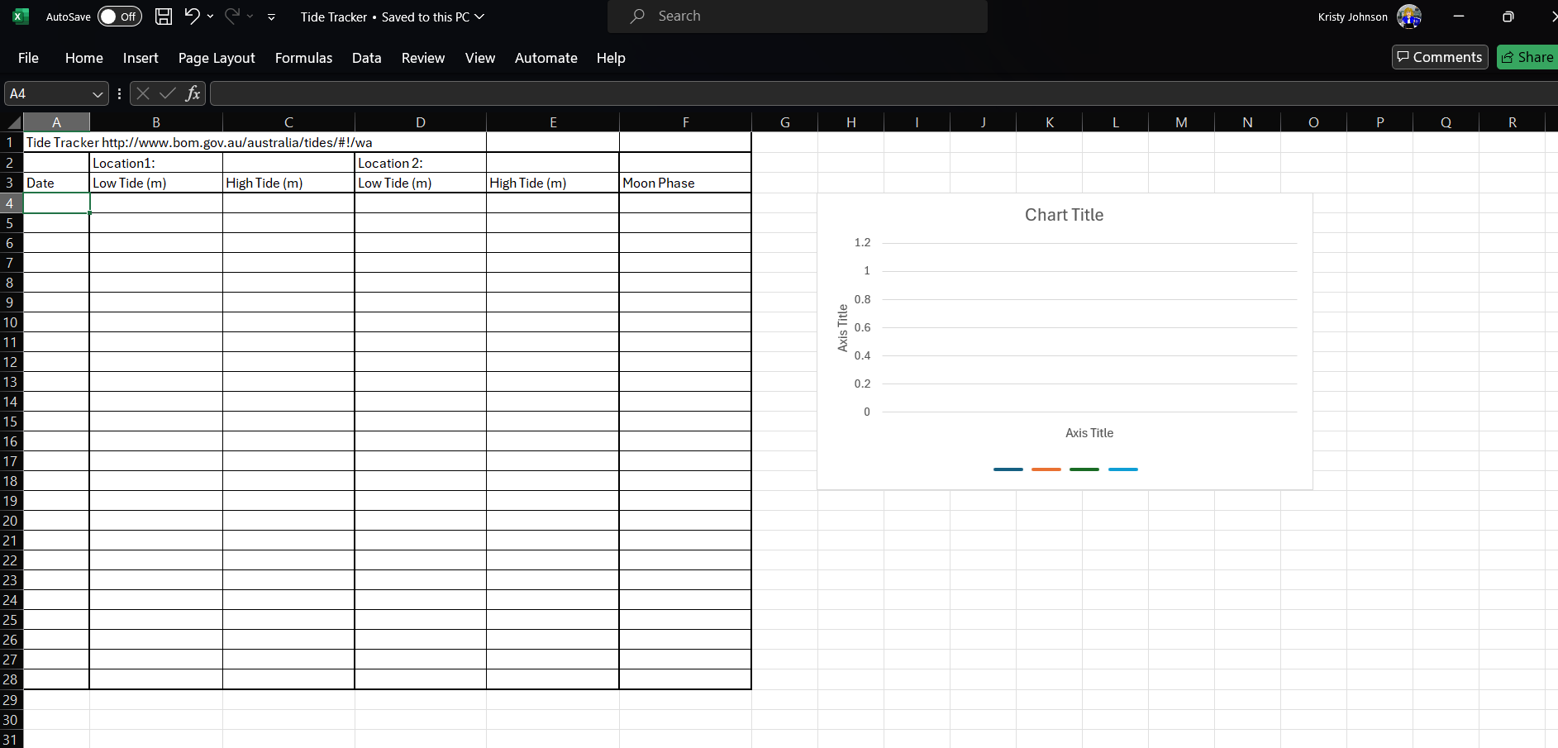
http://www.bom.gov.au/australia/tides/#!/wa
https://www.timeanddate.com/moon/phases/

Slide 7
Success criteria
Explain what causes tides
Describe spring tides and neap tides.
Investigate tide charts.

